Slide 1
UNIT 1
Introduction to e-commerce

Slide 2
What is Commerce ?
Commerce is the conduct of trade among economic agents. Generally, commerce refers to the exchange of goods, services or something of value, between businesses or entities

Slide 3
What is business ?
A business is defined as an organization or enterprising entity engaged in commercial, industrial, or professional activities. Businesses can be for-profit entities or non-profit organizations that operate to fulfill a charitable mission or further a social cause

Slide 4
Difference between Commerce and Business
Business and Commerce are word with similar meaning, but they also differ from one another .
Commerce focuses on buying and selling part of a business whereas there is much more to a business than just buying and selling.
Commerce is an abstract idea,while business is more physical in the sense that it can be owned by a person. One cannot say that he/she owns a commerce but can say that he/she owns a business. Business can be an entity , commerce refers to trade and trade- related activities .

Slide 5
Contd…
A business hold many activities such as planning,advertising,selling,buying,marketing ,accounting and supervising manufacturing etc. Where as Commerce, which mainly focuses on buying ,selling and activities directly related to buying and selling.For that , commerce is a subset of business.
When it comes to business,there are several types of businesses based on the structure. They are sole trader, partnership , trust and company. One cannot say that such variations exit when it comes to commerce.

Slide 6
1.1 Introduction
E-commerce is the process of buying, selling and exchanging the products, services and information between and among organizations and individuals
Every commercial transactions involves following three main components or dimensions
Product or service
Process
Delivery agent

Slide 7
In traditional commerce all above components are physical.
The commerce in which all or at least one of the above component is digital is called e-commerce.
In other words, e-commerce is a modern business methodology that addresses the need of organization and consumers to reduce cost while improving the quality of goods and services and increasing the speed of service delivery.

Slide 8
Technology driver for e-commerce development
Development in following factor
Processing
Storage
Network
Data Analysis Tools

Slide 9
Definition of e-commerce
IBM’s definition of e-commerce
“The transformation of key business processes through the use of internet technologies”
According to R. Kalakota
“E-commerce is buying and selling activities over digital media”

Slide 10
We can define e-commerce in the following Four perspective
1. Communications perspective,
Business process perspective,
Service perspective and
4. Online perspective

Slide 11
Communication Perspective
E-commerce from communication perspective is the delivery of information, products or services, or payments via telephone lines, computer networks, or any other means.

Slide 12
Business Perspective
commerce from business perspective, is the application of technology toward the automation of business transaction and workflows

Slide 13
Service Perspective
E-commerce from service perspective is a tool that addresses the desire of firms, consumers and management to cut service costs while improving the quality of goods and increasing the speed of service delivery

Slide 14
Online Perspective
Ecommerce from online perspective provides the capability of buying and selling products and information on the Internet and other online services

Slide 15
Basic Benefit of E-Commerce
1. Increased accessibility to customers
i) Allows people to carry out operations without barriers of time i.e. 24 hours a day, seven days a week.
ii) To reach out to global consumers easily and is also cost effective.
iii) It helps business to reach out new markets.
iv) Consumers and suppliers can be directly approached over the Internet.

Slide 16
Convenience of making comparisons:
E-commerce helps consumers to make comparisons while shopping. Automated online shopping assistants called hopbots score are available to find deals on anything from flowers to perfume

Slide 17
Increased Profitability
i)The direct cost to sale for an order taken from an web site is lower as compared to traditional means. Moreover processing errors are virtually eliminated in e-selling besides being faster and more convenient to visitor.
ii) It provides the solution by decimating the costs, which are incurred.

Slide 18
Innovation:
E-commerce enables business organization to create new products or services.
Improvement in consumer service:
There is a direct benefit in improvement of consumer service. High levels of customer satisfaction generate increased sales and increased profits.

Slide 19
Strategic Benefits:
It helps to reduce delivery time, labour cost and also the cost incurred in the following areas:
Document preparation.
Error detection and correction.

Slide 20
Pure and Partial E-commerce
Partial e-commerce is when a company will sell a good through the internet but the fulfillment of the good will need to take place in the "real" world. E.g., buying a book on Amazon, they will have to send it to you physically.
Pure e-commerce is when everything happens on the internet.E.g., buying music / movies on iTunes. in these case the productand services are digital

Slide 21
Important characteristics of e-commerce are:
It is about the exchanging of digitized information
It is technology enabled
It is technology mediated
It includes intra and inter organizational activities
Hence, e-commerce is the use of internet and web-technologies to transact business.

Slide 22
Information exchange
Technology
Buyer
Seller

Slide 23
1.2 E-commerce terminologies and Fundamentals
E-commerce consists of two major parties i.e. one is buyer side who buys item and other is seller side who sells item.
To accomplish this in e-commerce environment, different devices and application are required.

Slide 24
1.2 E-commerce terminologies and Fundamentals contd….
E-business: e-business is defined as the application of information and communication technologies to support all the activities of business.
Node: devices connected to the server
Protocol: rules and regulation of data transmission
Web browser: web browser is a software application which enable users to display and interact with text, image and videos.

Slide 25
1.2 E-commerce terminologies and Fundamentals contd….
e. Web server: delivers web pages to browser
f. Electronic-mall: An online shopping center where many stores are located is called e-mall.
g. Electronic store-front: single company’s web site where products and services are sold.
h. Portal: A portal is a Web site that offers a broad array of resources and services, such as e-mail, online discussion groups, search engines, and online shopping malls.

Slide 26
E-commerce framework
E-commerce application will be build on existing technology i.e. computers, communication network and communication software.
An infrastructure is defined as the foundation of the system
The hardware backbone of computers, router, server and other network technology provides half of the technology equation. The other half includes the software and communication standards that run on the hardware.

Slide 28
Framework tells about the detail of how e-commerce can take place. It defines actually how e-commerce implemented, how online trading or business can be done. It defines important components that should be present to do some transaction.

Slide 29
Network Infrastructure
Network Infrastructure is called as “INFORMATION SUPERHIGHWAY” is the path through which actual information flows and moves between sender and receiver.
Information Superhighway consists of telecommunication companies that provide telephone lines.
Cable TV systems that provide coaxial cables and direct broadcast satellite networks.
Wireless companies that provide mobile radio and satellite networks.
Computer networks include private networks and public data networks like the Internet.
All these modes of communication are interconnected. They are connected with routers, switches, bridges, gateways etc which are devices to connect similar and different network. All the information flow on these lines and through these devices and reach the desired destinations

Slide 30
Multimedia Contents and Network Publishing -
The Information Superhighway is the transportation foundation that enables the transmission of content. The most prevalent architecture that enables networking publishing is the World Wide Web. The web allows small businesses and individuals to develop content in the form of Hypertext Mark-up Language (HTML) and publish it on a web server. Web provides a means to create product information (content) and a means to publish it in a distribution centre. (Network server).

Slide 31
Messaging and Information Distribution Infrastructure
The information content transferred over the network consists of text, numbers, pictures, audio and video. But the network does not differentiate among content as everything is digital that is, combinations of zero’s and ones. Once contents has been created and stored on a server, messaging and information distribution methods carry that content across the network.
Messaging vehicle is called middleware software. Messaging and information distribution include translators that interpret and transforms data formats.

Slide 32
Common Business Services Infrastructure
This infrastructure includes the different methods for facilitating online buying and selling processes. In online commerce, the buyer sends an electronic payment as well as some remittance information to the seller.

Slide 33
Public Policy and Technical Standards
Public Policy and Technical Standards are two support pillars for all e-commerce applications and infrastructure.
Public policy related to e-commerce encompasses such issues as universal access, privacy and information pricing.
Technical Standards dictate the specifics of information publishing tools, user interfaces and transport.
Standards are essential to ensure compatibility across the entire network of world.

Slide 34
Can Also be explained as follws

Slide 35
E-commerce framework
E-commerce application will be build on existing technology i.e. computers, communication network and communication software.
An infrastructure is defined as the foundation of the system
The hardware backbone of computers, router, server and other network technology provides half of the technology equation. The other half includes the software and communication standards that run on the hardware.

Slide 36
The framework of e-commerce consists of three parts
First part: The first part consist of a variety of e-commerce applications including inter and intra organizational and electronic markets.
Second part: The second part of the building block of infrastructure consist of
Common business services for facilitating the buying and selling processes
Messaging and information distribution is a means of sending and retrieving information

Slide 37
Multimedia content and network publishing for creating a product to communicate about the e-commerce applications
Information superhighway infrastructure consists of the network communications, telecommunications, internet technologies etc.

Slide 38
Business Applications
Online shopping and advertizing
Online banking
Supply chain management: Supply Chain Management is a term that encompasses the coordination of various department of a company. It includes order generation, order taking, order fulfillment and distribution of products or services or information.
Video on demand (Display) : are systems which allow users to select and watch/listen to video or audio content when they choose to, rather than having to watch at a specific broadcast time
E-Procurement

Slide 39
c) Third part
The third part consists of the public policy and technical standards to support the application and the infrastructure
Policy governs issues like universal access privacy , information pricing, accessing information, protect consumer from fraud, protect consumer’s right, detect information pirating.

Slide 40
Technical standards, to dictate the nature of information publishing, user interfaces and transport in the interest of compatibility across the entire network

Slide 41
NOTE
A clear cut government policy, public related issues, information access issues on internet, privacy of information, social and legal issues are the one pillar of e-commerce
Uniform technical standard for information publishing, user interface, electronic documentation, multimedia and network protocol are another pillar of e-commerce.

Slide 42
1.4 Elements of e-commerce application
E-commerce applications needs standard infrastructure. In nepal we are using NTC network and other some networks as a backbone of e-commerce application.
Basic three blocks of e-commerce or elements of e-commerce applications are:
Consumer access device
Network provider
Information delivery server

Slide 43
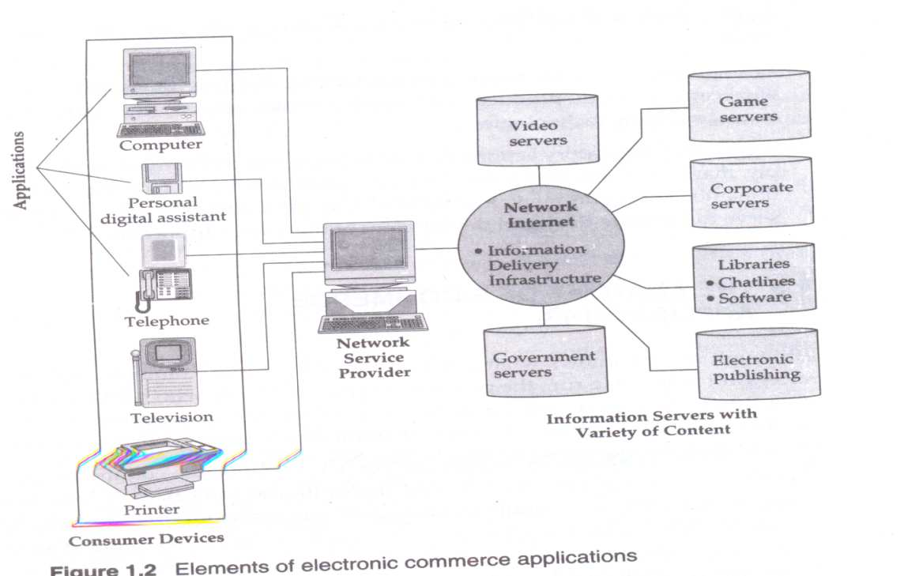

Slide 44
Consumer access device:
Consumer can access the e-commerce system through existing telecommunication network, PCs, telephone etc.
Consumers use these suitable access device to deliver the information
For e.g. to access telephone data, consumer can use ordinary telephone, to access audio and video data consumers can use PCs or laptop .

Slide 45
b. Network provider
Network is the backbone of e-commerce because e-commerce needs a network infrastructure to transfer multimedia contents.
Also being e-commerce as a global commerce, it needs high capacity interactive electronic pipelines i.e. capable of simultaneously supporting a large number of e-commerce applications.

Slide 46
c. Information delivery server
The server which delivers the information upon request with large scale distribution and full security management is known as information delivery server.
These servers are combination of hardware and software which convert raw data into usable information and deliver when and where user need it.

Slide 47
Dimensions of e-commerce
Global reach: An e-commerce techno has global reach that is permitting commercial transactions to cross cultural and national boundaries far more conveniently and cost effectively
Universal standard: This technology operates according to universal standard shared by all nations of the world

Slide 48
c. Interactivity : It is an interactive that means it allows for two ways communication on a much more massive and global scale
d. Information density: Information density is the total amount and quality of information available to all market participants. E-commerce technology increases information density.

Slide 49
e. Personalization and customization:
. The technology permits personalization and customization with the marketing messages to specific individuals by adjusting the messages to a person name, interest and past purchases.
. Personalization of marketing message and customization of product and services are based on individuals characteristics.

Slide 50
1.6 Benefits of e-commerce
Benefits to organization
Expands the market place to national and international market
Reduces cost of creating, processing, distributing, storing and retrieving paper based information
Allows for customization of products and services
Reduces delivery time
Reduces telecommunication cost

Slide 51
b. Benefits to consumer
Enables consumers to do transactions from almost any location
Provides consumers more choices of interest with less cost of services and price
Consumers can receive relevant and detail information about the related goods
Improved customer service
Allows consumer to interact with other consumers in electronic communities and exchange their ideas as well as compare experience.

Slide 52
c. Benefits to society
Enables individuals to work more at home and less travelling for shopping
Facilitates delivery of public services at reduced cost, increases effectiveness and improves quality.

Slide 53
limitations of e-commerce
Technical limitations
Non-technical limitations

Slide 54
Technical limitations
Cost of a technological solution
Some protocols are not standardized
Insufficient telecommunication bandwidth
Software tools are not fixed
Difficulty in integrating e-commerce infrastructure with current organizational IT system.

Slide 55
b. Non-technical limitations
Customers expectations may not meet
Security and privacy issues
Cultural and legal obstacles

Slide 56
E-commerce opportunities for industries
Financial services
Stock trading
Banking
Legal and professional services
Tour and travel
Healthcare

Slide 57
The driving forces for e-commerce
The various environmental business pressures on companies today can be grouped into three categories: market, social and technological
a. Market and economic pressure: The parameters which works as driving forces for market are: strong competition, global economy, low labor cost.

Slide 58
b. Societal and environmental pressures: government regulations, reduction in government subsidies, rapid political changes
c. Technological pressures: Rapid technological changes, new technology , information overload

Slide 59
Mobile Commerce( M-commerce)
M-commerce is the buying and selling of goods and services through wireless handheld devices such as cellular telephone and personal digital assistants (PDAs).
Also Known as next-generation e-commerce
M-commerce enables users to access the Internet without needing to find a place to plug in.

Slide 60
M-Commerce Contd..
M-commerce can also be define as online sales transactions that use wireless electronic devices such as hand-held computers, mobile phones or laptops.
These wireless devices interact with computer networks that have the ability to conduct online merchandise purchases

Slide 61
Advantage of M-Commerce
Completely Customization: The service provider has access to data about the user’s preferences and status which facilitates better, personalized service. In addition, the service provider can be constantly updated about the current status and location of the customer so that the service can be customized; for instance, a request for a certain product can be met with the nearest possible source

Slide 62
More Convenience: The small size and ease of use of mobile receivers, coupled with freedom from problems caused by infrastructure, makes for a higher degree of user convenience
Expanded reach: The presence of a wireless link between the customer and the service provider eliminates the need for a fixed interface such as a computer for communication. Providers of e-commerce services can therefore reach customers over a longer range, creating the opportunity for new value added services

Slide 63
Quicker access: connecting through a mobile is faster than dial-up connections using wire line modems.
Electronic wallet:Analysts believe that easy mobile payment is one of the main prerequisites for the success of m-commerce, When the mobile phone can function as an electronic wallet for mobile payments, including micropayments, application developers and service providers will find it attractive to introduce new mobile communication services to the market.

Slide 64
Ubiquity: The use of wireless device enables the user to receive information and conduct transactions anywhere, at anytime
Localization: The emergence of location-specific based applications will enable the user to receive relevant information on which to act.

Slide 65
M-Commerce Vs E-Commerce

Slide 66
 | M-Commerce | E-Commerce
Devices used | Handheld devices such as smartphones and tablets | Computers, laptops, …
Connection-dependency | Mandatory (*) | Mandatory (*)
Reachability | With push notifications in place, mobile commerce can reach a wider range of users even when they’re on the go. | Limited
Mobility | High: Users can make transactions everywhere as long as they are connected to the Internet. | Low: Users can make transactions on their computers and laptops with limited mobility
Ease of Use | User Experience on mobile devices is optimized for as little taps-on-screen per transaction as possible | Harder to navigate in the desktop websites of eCommerce stores.
Platform | Web stores and native apps | Web stores
Payment Gateway | Caller’s rate, mobile banking or user’s credit card | Credit Cards
Location-tracking capability | Yes | No
Security | Rely on the web security combined with built-in mobile security features | Rely mainly on the web security

Slide 67
Business models for e-commerce
A business model is a set of planned activities designed to result in a market place.
The business model is at the center of business plan
A business plan is a document that describes organization’s business model
An e-commerce business model is a term used broadly for the act of doing business using internet or other electronic means
This model links employees, supplier, partners and consumers
E-business means transformation of key business processes through the use of internet technology.

Slide 68
Types of e-commerce
B2C
B2B
C2C
C2B

Slide 69
Business To Customer(B2C)
This is most common form of ecommerce.
These systems allow businesses to sell goods and services to consumers via the internet.
Group of these online shop-fronts are called e-malls and are essentially online shopping centres.

Slide 70
Contd…
In B2C e-commerce companies sell goods to consumers online in a dynamic environment.
Each transaction under B2C represents an individual buying online.
E.g. amazon.com, pets.com , eDiets.com, Dell.com etc

Slide 71
Steps in B2C E-commerce
Customer uses a browser and locates vendor or he has vendor's web page address
Sees Vendor's web page listing of items available, prices etc
Customer selects item and places order. Order may include credit card details or may be cash on delivery
Vendor checks with credit card company customer’s credit
Credit card company OKs transaction
Vendor acknowledges Customer’s order and gives details of delivery date, mode of transport, cost etc
Vendor orders with distributor who ships item to vendor's warehouse from where item supplied to customer
Customer's credit card company debits his account, credits vendor's account and sends bill to customer for payment

Slide 72
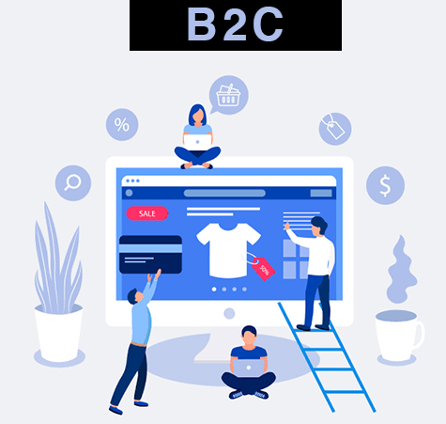

Slide 73
Business To Business(B2B)
These systems are designed for businesses to collaborate or sell goods and services to each other.
In the past EDI was conducted on a direct link of some form between the two businesses where as today the most popular connection is the Internet.
The two businesses pass information electronically to each other.
B2B e-commerce currently makes up about 94% of all e-commerce transactions

Slide 74
Advantage Of B2B
Improved customer satisfaction
Improved inventory system
Easy and cost effective marketing
Coordination between manufacturers, distributors and dealers.
Better management of business

Slide 75
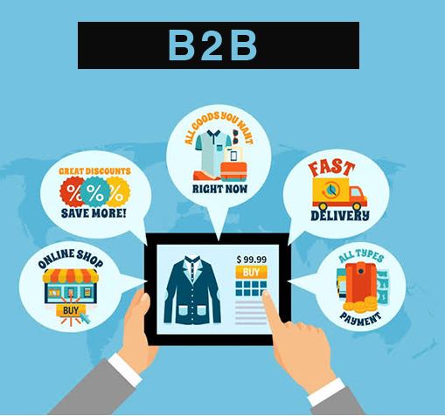

Slide 76
Customer To Customer (C2C)
Consumer to consumer, or C2C, is the business model that facilitates commerce between private individuals. Whether it's for goods or services, this category of e-commerce connects people to do business with one another.
A solid example of C2C transactions would be the classifieds section of a newspaper, or an auction
Eg. Hamrobazar.com,ebay.com etc

Slide 77
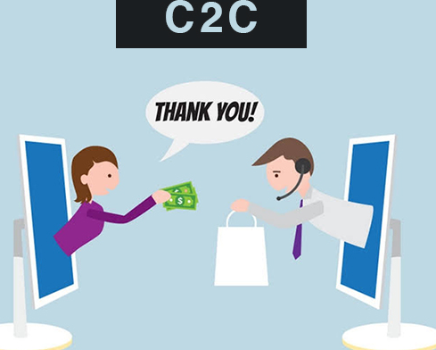

Slide 78
Consumer To Business
Instead of a business advertising a service to someone and waiting for them to take it up, customers now demanded a service for a price that they’re happy to pay and waited for a business (or freelancer) to fill the gap.
Consumer to Business transactions occur online when, for example, a Blog owner sells advertisement space to Target on their Blog
Also, someone with a certain skill can provide a service to a company without being in business themselves, such as a consumer building a website for a local small company

Slide 79
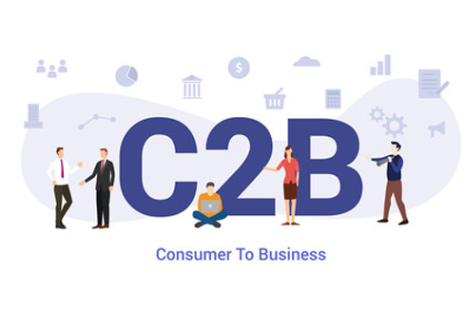

Slide 80
Other Models..
G2B or G2C (Government to Business or Government to Consumer)
These systems involve the government providing services to business and consumers. These services may range from the online provision of information through to electronic lodgement of forms or tax returns

Slide 81
location based commerce (L-Commerce)-
M comm. transaction targeted to individual in specific location at specific time.
C-Commerce-(Collaborative Electronic Commerce)-
EC model in which individual or group communicate or collaborative online

Slide 82
b. B2B
E.g.metalsite.com, SHOP2gether.com, dell.com
c. C2C
e.g. ebay.com, hamrobazar.com
d. C2B
e.g. priceline.com

